Slide 1
Flow-Controlled and Clock-Distributed Optical Switch and Control System
Presentors:
Hanqin Cao (hc3359)
Yiqing Cao (yc4138)

Slide 2
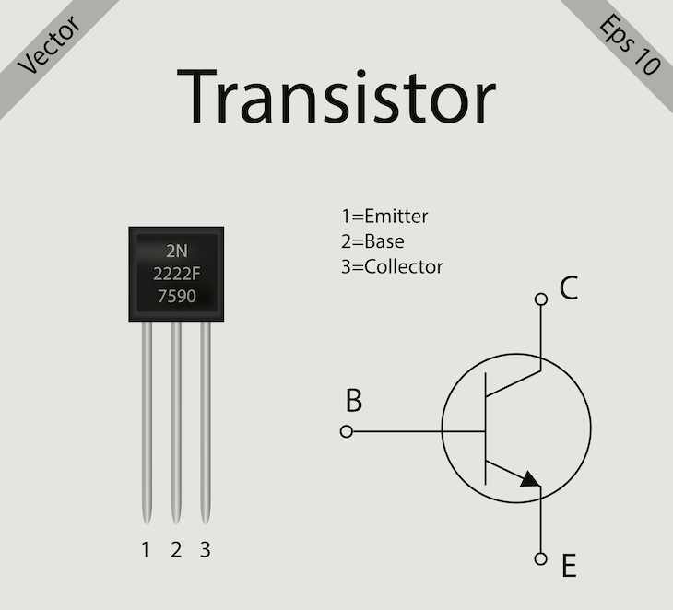
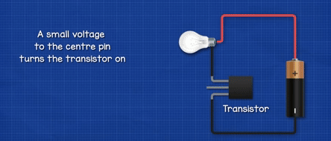
Electrical Switch (transistors)
~GHz
Power Consumption/ Heat
Performance issues
Miniaturization (nm level) with atom size limitation
https://builtin.com/hardware/transistor
https://orbray.com/magazine_en/archives/501
https://www.youtube.com/watch?v=J4oO7PT_nzQ&t=2s&ab_channel=TheEngineeringMindset

Slide 3
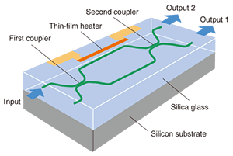
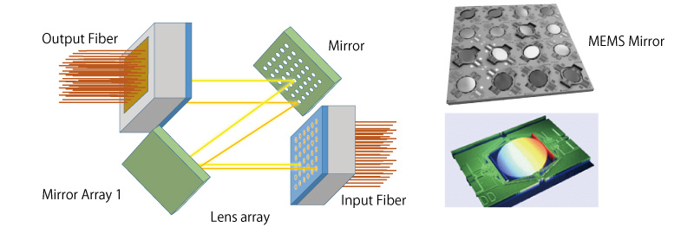
Optical Switch
~THz
Higher Bandwidth
Latency
Sensitivity to Environment
Limited Compatibility / Standardization needed
Waveguide Design
Micro-Electro Mechanical Systems

Slide 4
Problems to be solved at data center server level
Ball Grid Array (BGA) technique bottleneck at pin-density → unlimited bandwidth of optical switches
Power, latency, and cost of OEO conversions
Switches frequency to be time-synchronized
Lack of Optical Random access memories (RAM) → Clock and data recovery (CDR) time
Burst-mode CDR receivers with oversampling (complexity and cost issue)
Universal solutions and scalable topology
A. I. Abbas and G. E. R. Cowan, "Fast-Locking Burst-Mode Clock and Data Recovery for Parallel VCSEL-Based Optical Link Receivers," in IEEE Access, vol. 10, pp. 34306-34320, 2022, doi: 10.1109/ACCESS.2022.3162927.

Slide 5
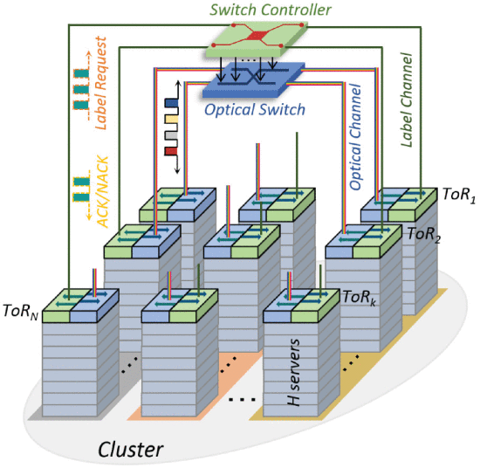
Flow-controlled and clock-distributed optical switch system deployed at the cluster unit.

Slide 6
Label Control Mechanism
Switch controller
Switch
label for each data
……
Possible Switch
Tor + Buffer
Tor + Buffer
Tor + Buffer
Tor + Buffer
Data
Data
Data
Data
Data
Data
Data
Data
Data
Data
Data
Data
Frames destining to the identical rack are directly flowed to the intra-rack servers
Frames destining to the other racks are stored at the electrical buffer (RAM), where the buffer block stores the inter-rack traffic with the same rack destination, respectively.
Most-occupied buffer block will be selected and grouped to generate an optical data packet at every time slot

Slide 7
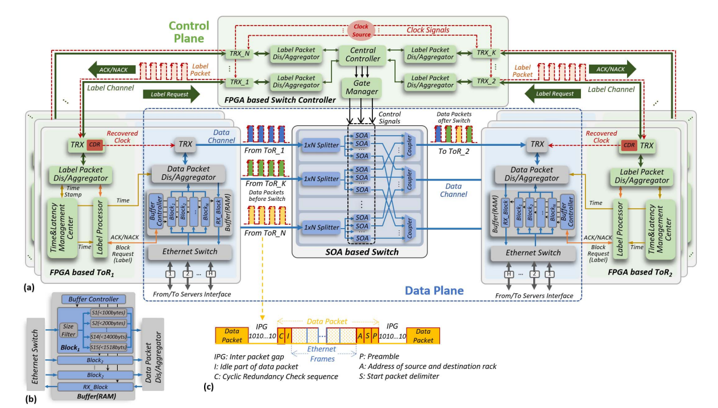

Slide 8
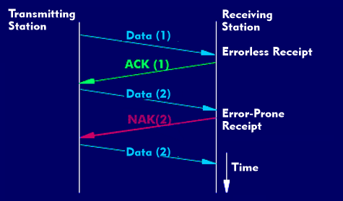
Optical Flow Control (OFC) Technique
Packet contention
two or more packets from different source ToRs have the same output port at the same time slot.
Flow Control ACK/NACK

Slide 10
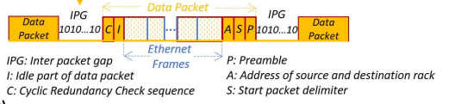
Clock Distribution Technique
Clock and data recovery (CDR) for frequency adjustment
Onboard Clock Source
Phase adjustment in few nanometers by the system
Guarantee of continuous data traffic to maintain the recovered clock with good quality
Ethernet protocol
Pulse transitions (“1010...1010”)

Slide 11
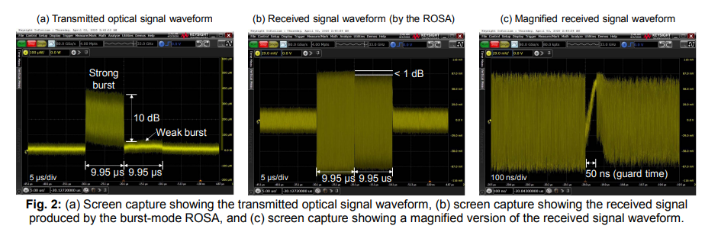
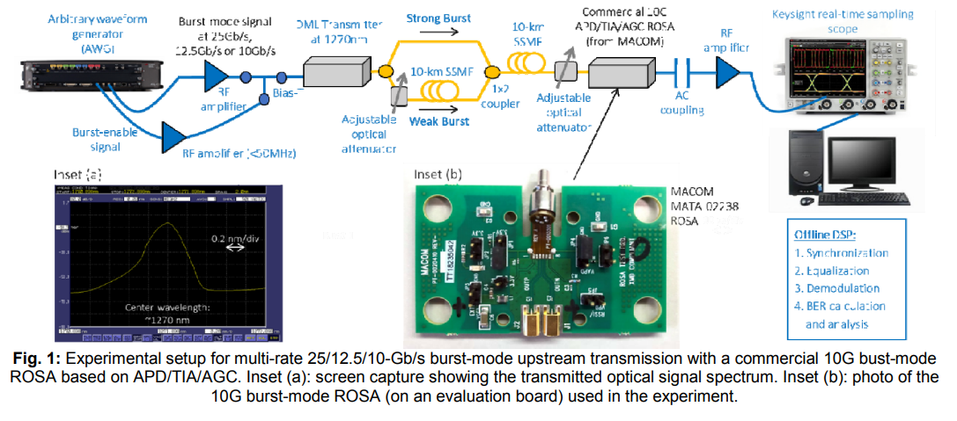
Burst mode CDR

Slide 12
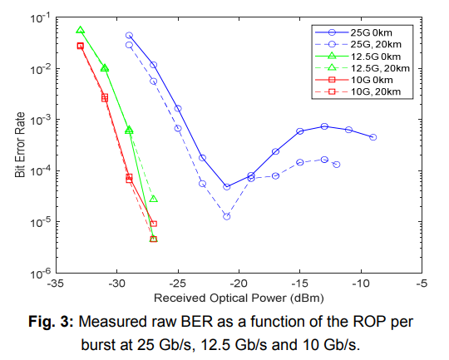
Burst mode and clock-distributed system
 | Clock distributed | Burst Mode
clock and data recovery | 3.1ns | 92ns
packet loss | < 3.0E-10
Latency | 3 μs server to server | 50 μs (10km)
Long distance (~km) |  | ✓
Burst multi-rate burst |  | ✓
Scalability | ✓

Slide 13
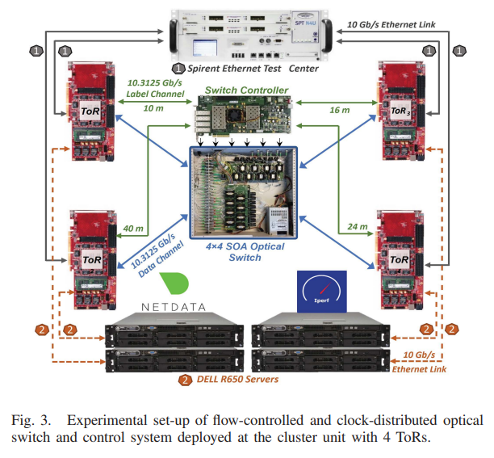

Slide 14
Simulation In MatLab
CentralController Class
Properties:
LabelPacketList
OpticalConfiguration
ACKSignals
ToRNumber
TimeStamp
Host Class
Buffer Class
ToR Class
Properties:
EthernetFrames
DestinationToR
DestinationHost
SourceToR
SourceHost
TimeStamp
Properties:
BufferSize
Block
MostOccupiedBlock
SourceHosts
SourceToR
TimeStamp
IntraRackData
BufferPacketLossRecord
Properties:
SourceToR
LabelPacket
DataPacket
BufferToSend
BufferRecieved
ACKState
TimeStamp
OpticalSwitch Class
Properties:
DataPacketList
InterTrafficData
ToRNumber

Slide 15
Simulation In MatLab
Host Class
ToR Class
CentralController Class
Functions:
DestinationAssignment
Functions:
DataPacketAggregator
LabelPacketAggregator
BufferUpdate
ACKStateUpdate
Functions:
PacketContention
OpticalConfigurationGenaration
ACKSignalGeneration
Buffer Class
Functions:
ProcessHosts
FindMostOccupiedBlock
IntraRackTraffic
BufferStackCheck
OpticalSwtich Class
Functions:
ProcessDataPackets
InterRackTraffic

Slide 16
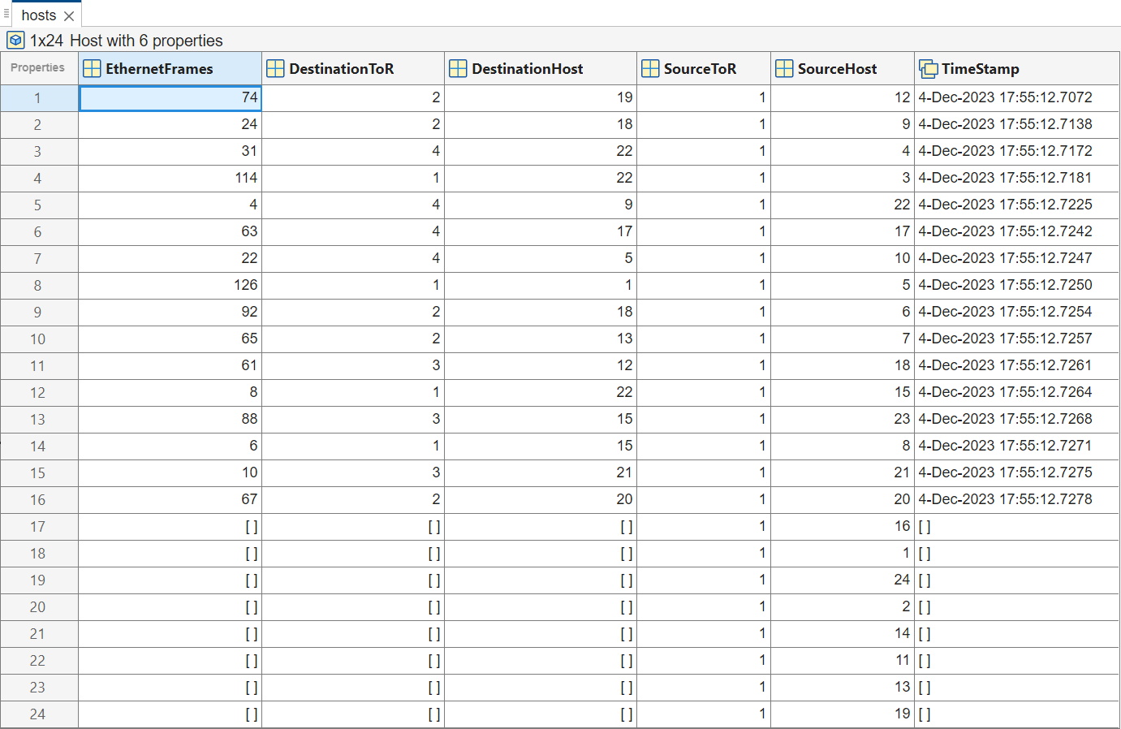
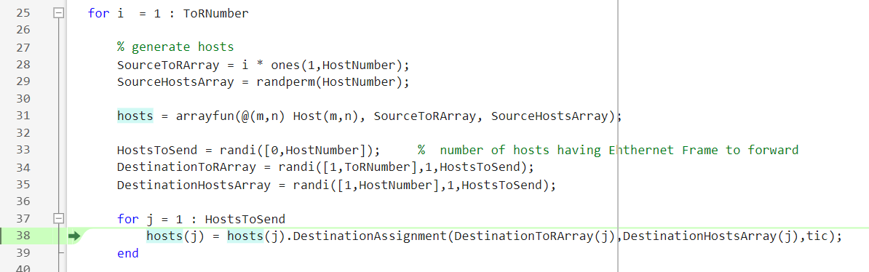
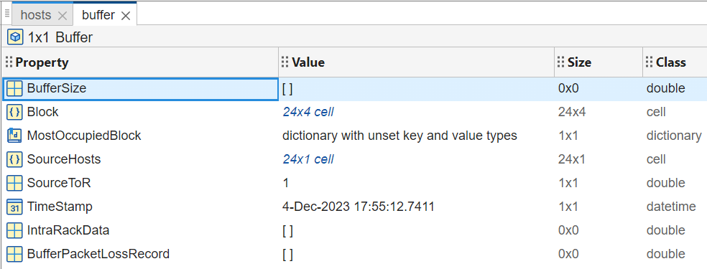
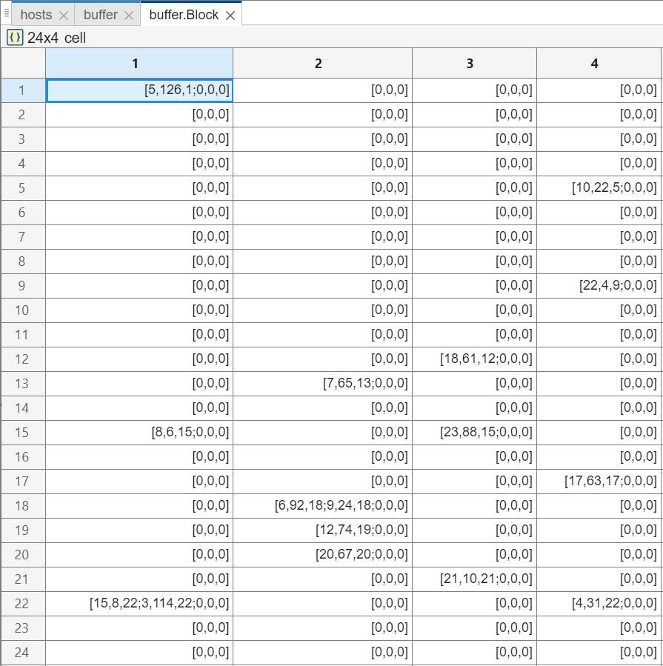
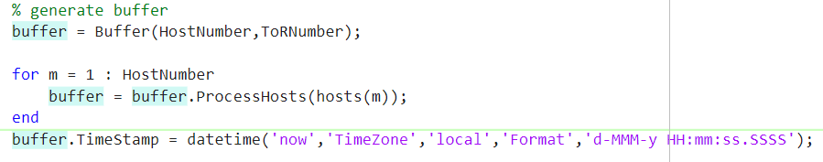
Simulation In MatLab
[DestinationHost, EthernetFrame, SourceHost] →

Slide 17
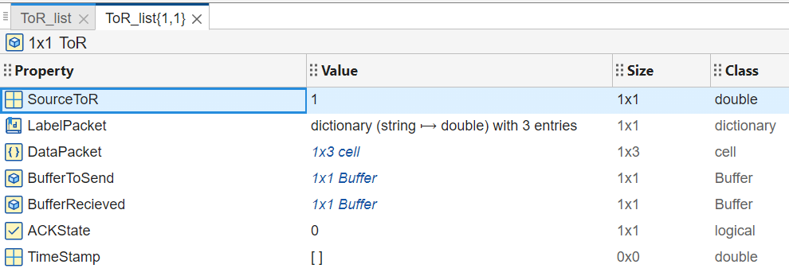
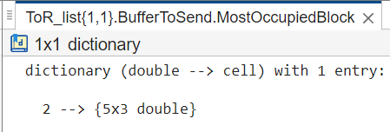
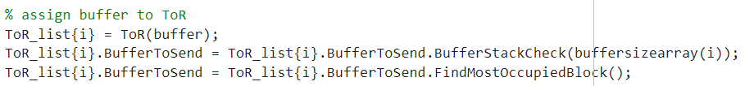
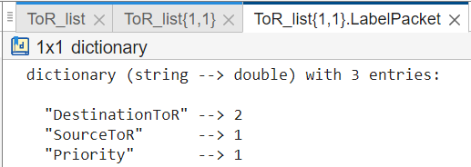
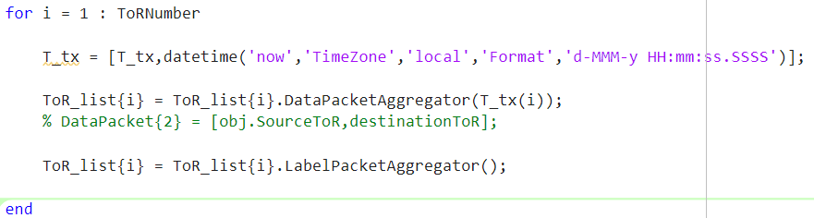
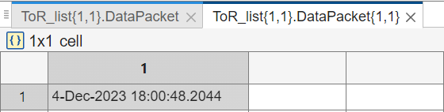
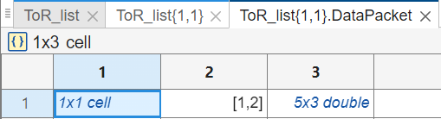
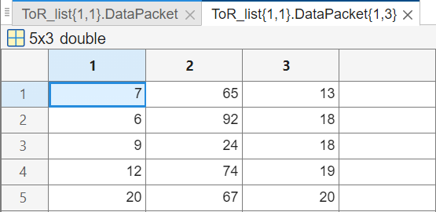
Simulation In MatLab
← Label Packet
↑ Data Packet

Slide 18
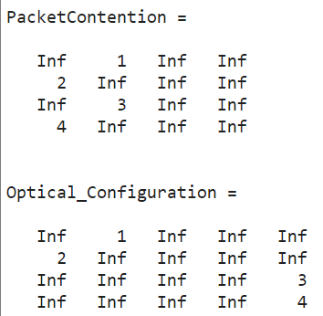
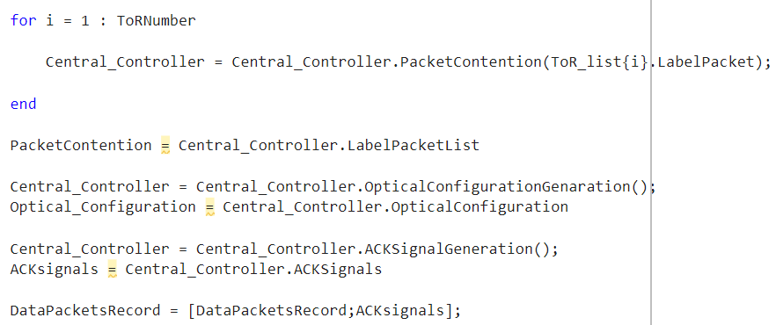
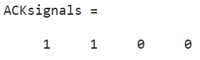
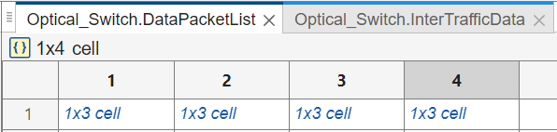
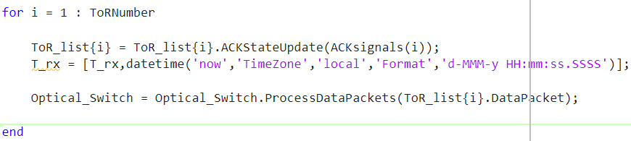
Simulation In MatLab
Row: Source ToR
Column: Destination ToR

Slide 19
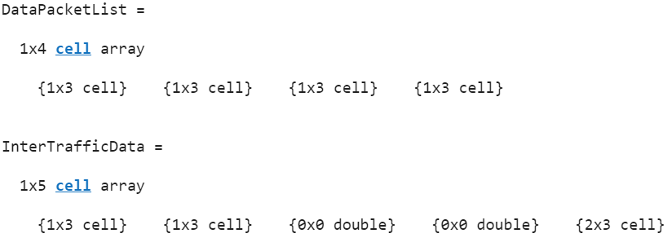
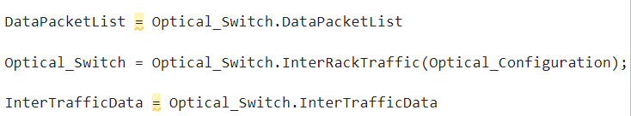
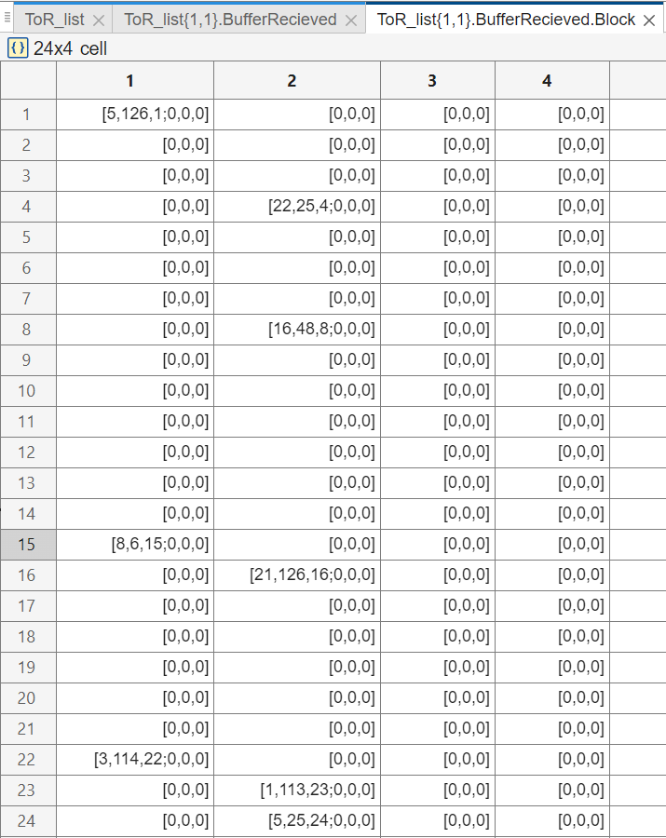
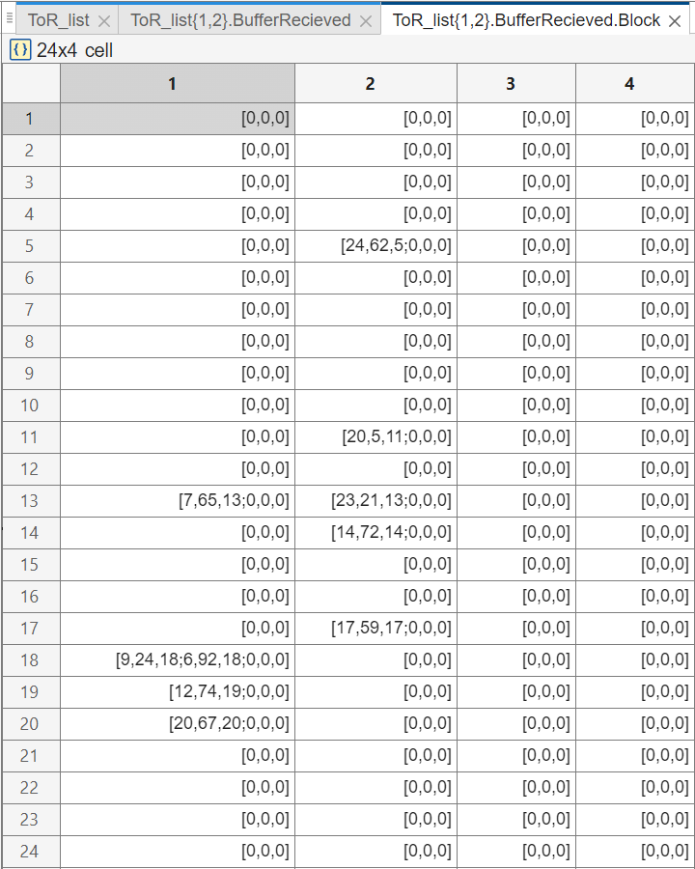
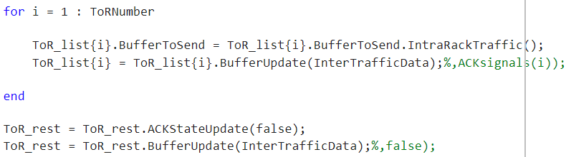
Simulation In MatLab

Slide 20
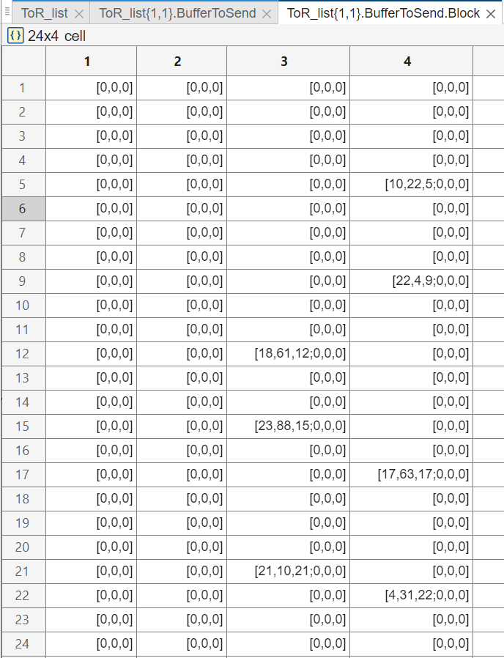
Simulation In MatLab

Slide 21
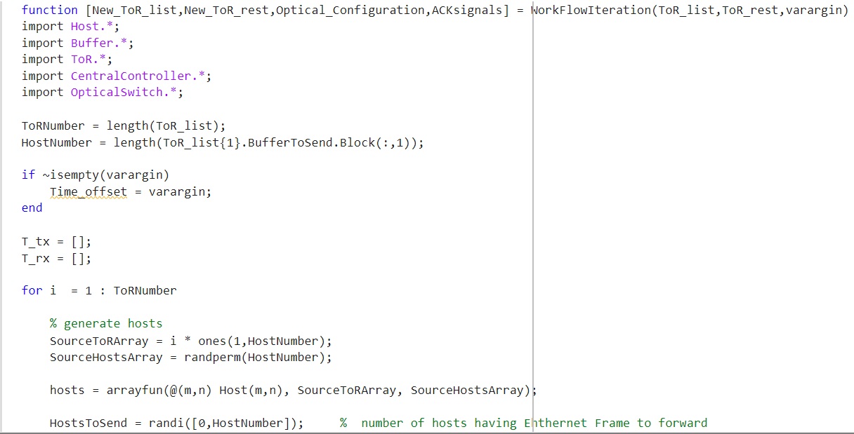
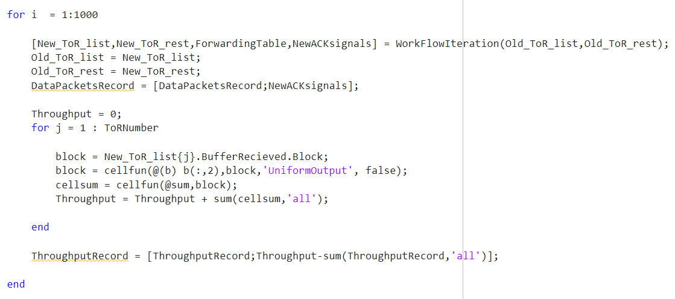
Simulation In MatLab

Slide 22
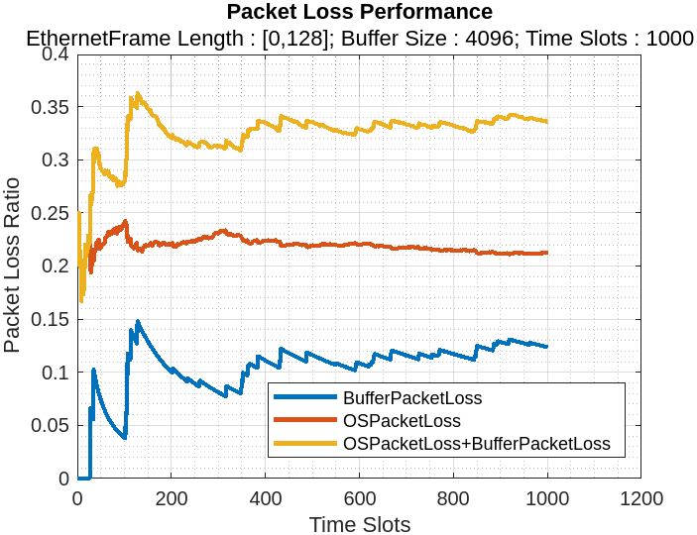
Data Analysis
ToTalPackets = BufferPacketLoss + SuccessfullySentPackts+OpticalSwitchPacketLoss
PacketLossRatio = PacketLoss/TotalPackts

Slide 23
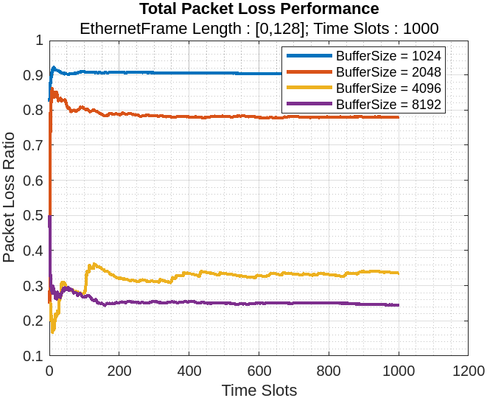
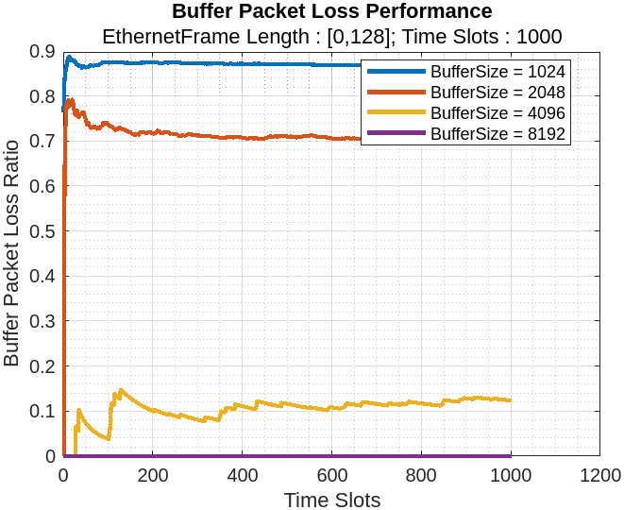
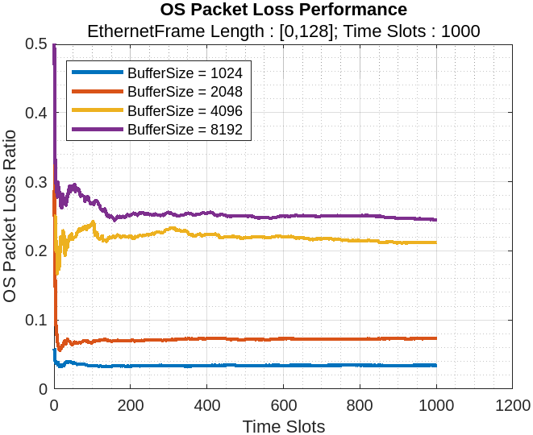
Data Analysis
ToTalPackets = BufferPacketLoss + SuccessfullySentPackts+OpticalSwitchPacketLoss
PacketLossRatio = PacketLoss/TotalPackts

Slide 24
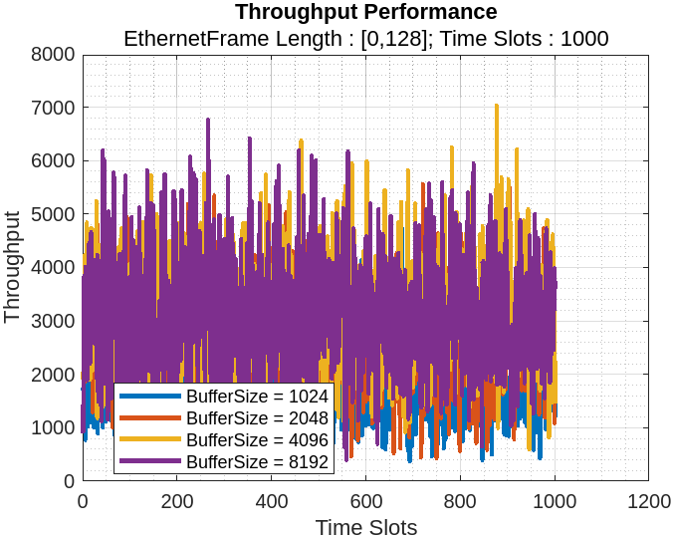
Data Analysis

Slide 25
Conclusion
With the new designed flow-controlled and clock-distributed optical switch and control system, we achieve,
43.4 ns optical switch configuration time
< 3.0E-10 packet loss rate resulting from the packet contention
3.1 ns fast CDR time (92 ns for burst mode CDR)
zero buffer overflow-caused packet loss
< 3 μs server-to-server latency with a smaller electrical buffer of 8192 bytes at a traffic load of 0.5
Preventing deployment of complex burst mode CDR receivers while burst mode works well under high traffic load and Dynamic Range of loss rate

